Slide 1

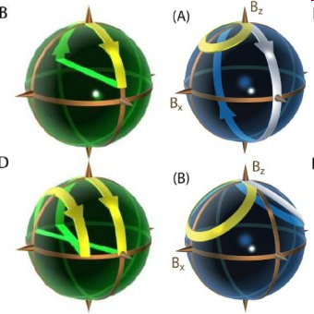
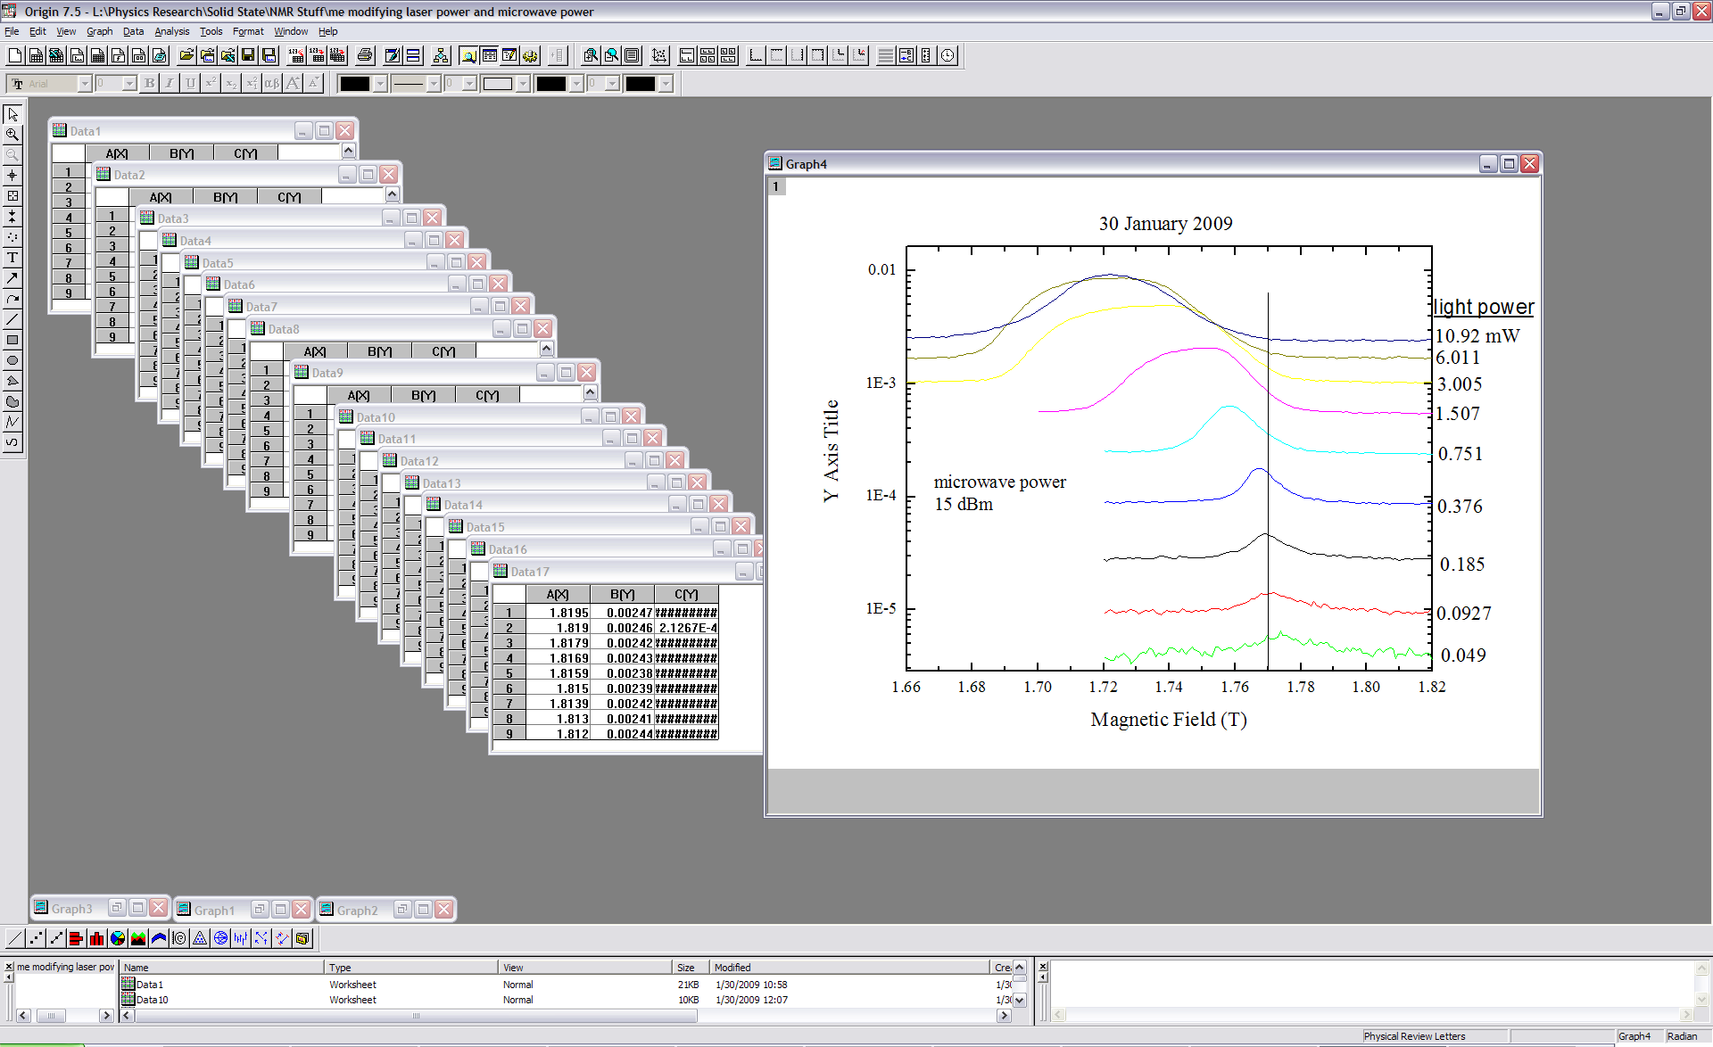
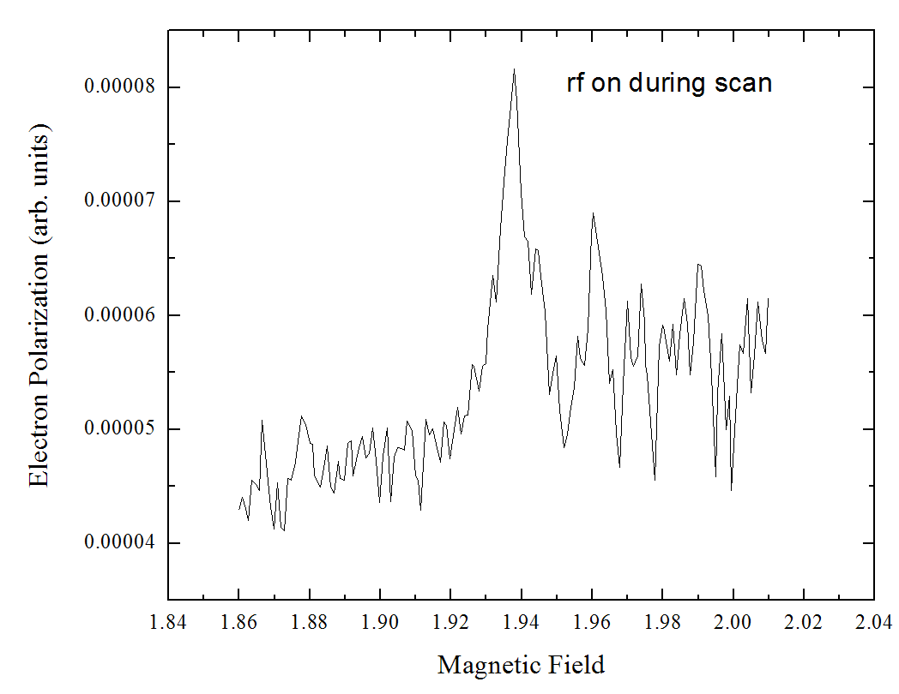
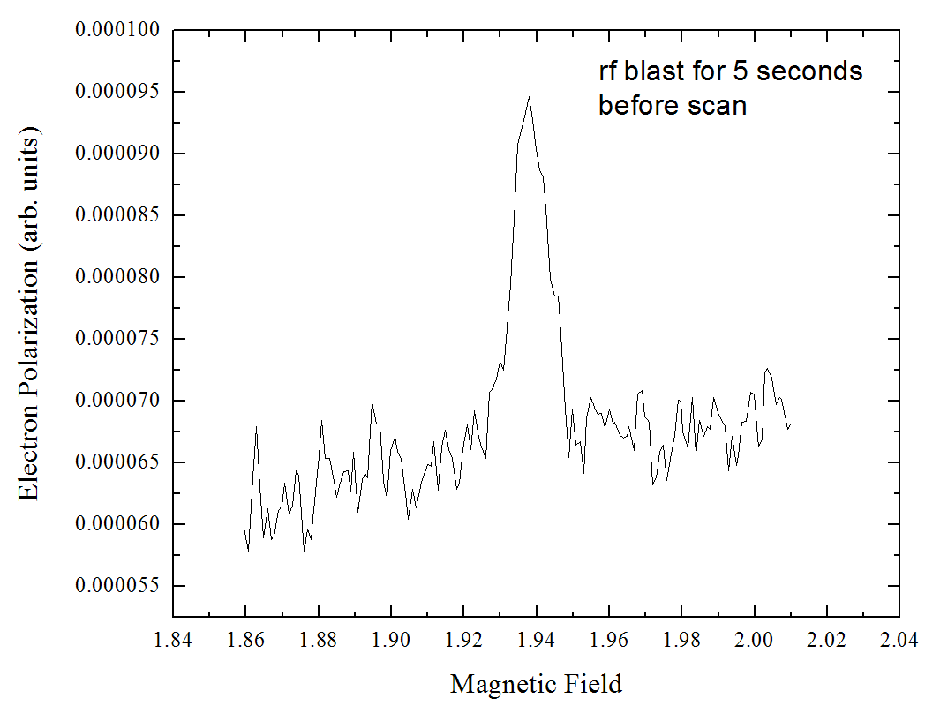
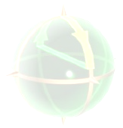
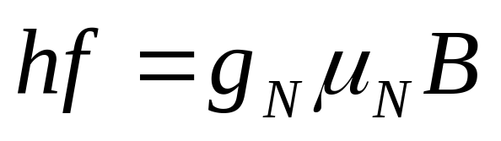
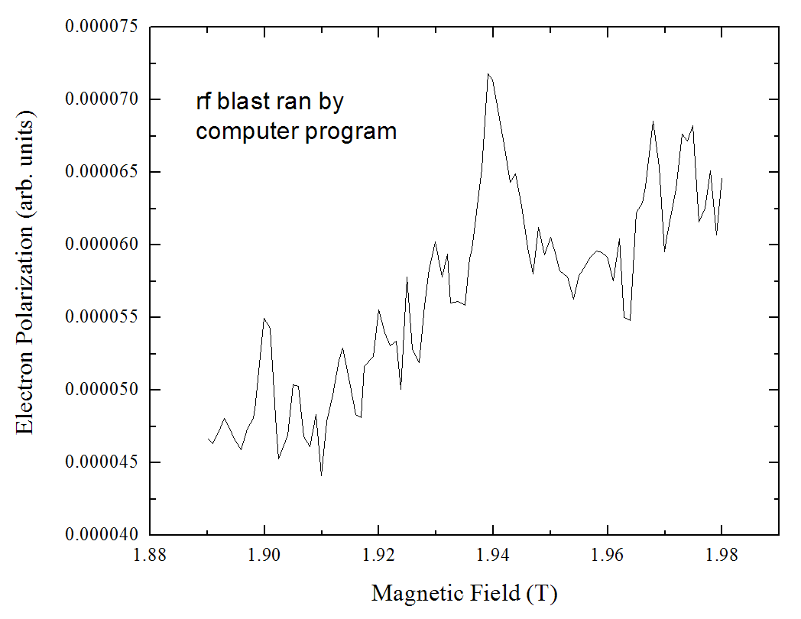
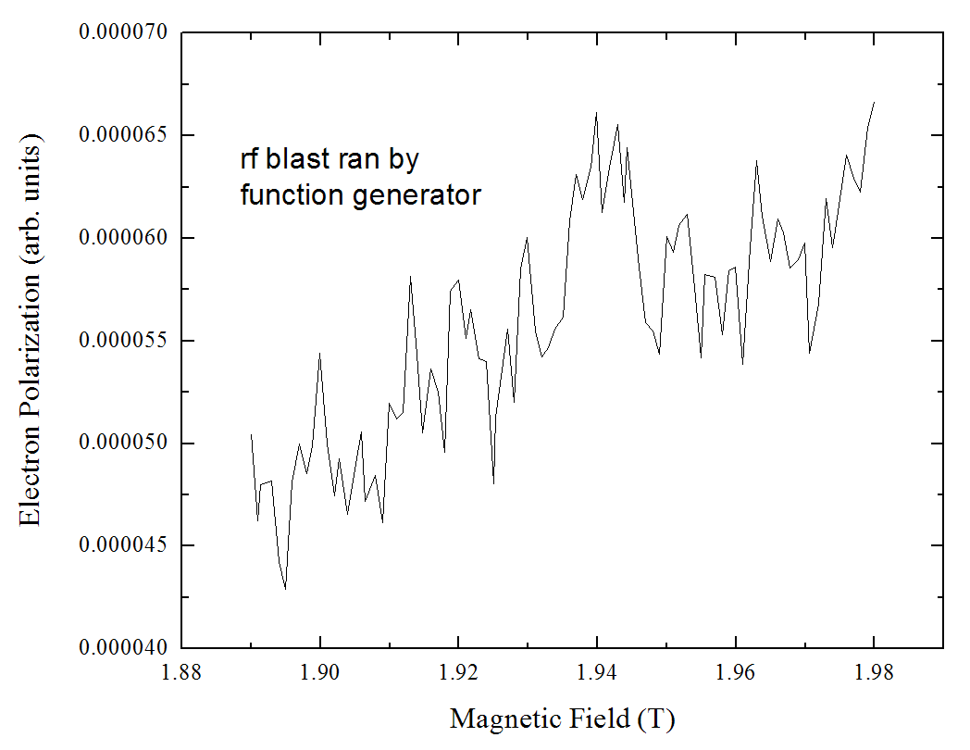
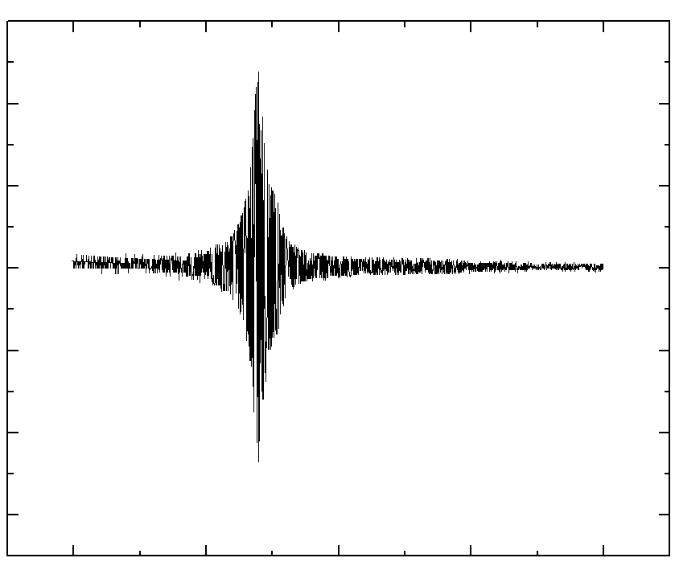
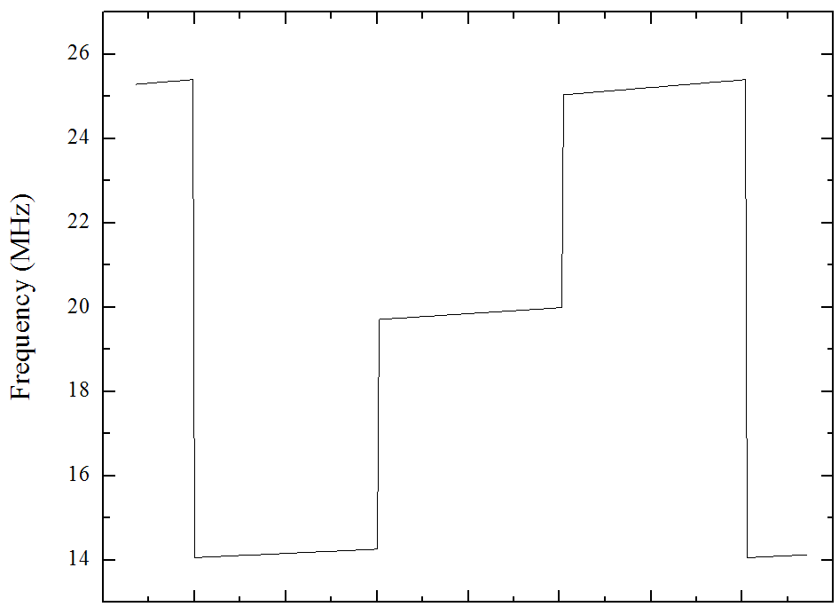
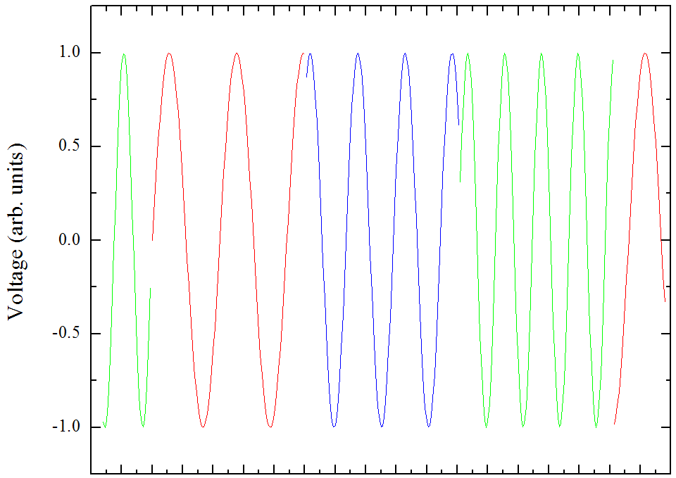
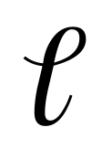
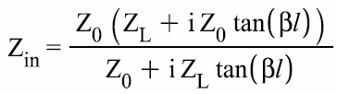
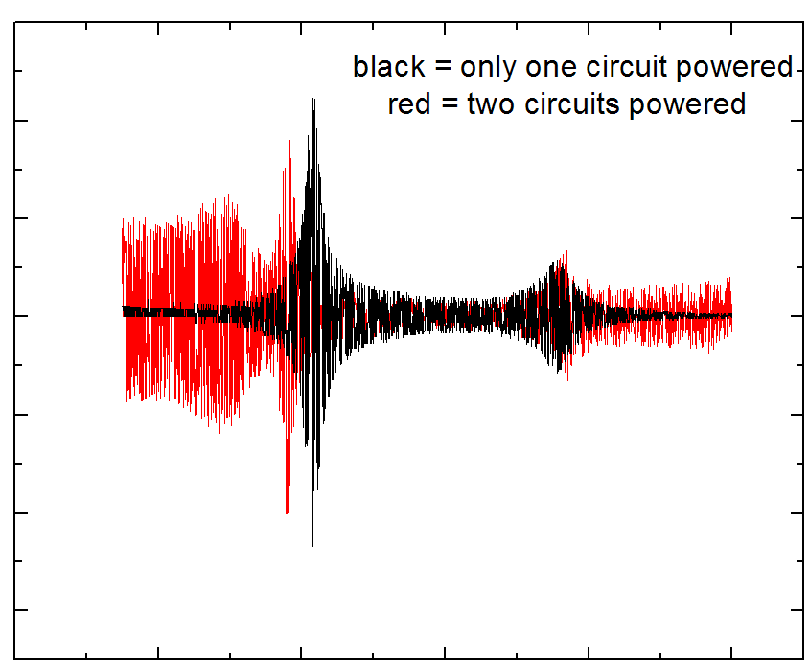
Nuclear Effects on Electron Spin Resonance in Gallium Arsenide
Mitch Jones, John Colton, Steve Brown, Michael Johnson, Benjamin Heaton, Daniel Jensen
Brigham Young University Provo, Utah
Work supported by:
National Science Foundation
Why Do We Need Nuclear Magnetic Resonance (NMR)?
Electron Spin Resonance (ESR) is greatly affected by
nuclear spins due to hyperfine interaction.
B_{eff} α Nuclear Polarization.
Perturbations of electron spin polarize nuclei which in return affect the spins.
Causes:
  High laser (optical pumping)
  High microwave power resonates spins too strongly
Possible Problems:
  Local inhomogeneities created
  Resonant field unpredictably shifted
Nuclear resonant frequencies determined by
How is nuclear polarization recognized?
Broadened and shifted peaks are characteristic of interactions between polarized nuclei and electron spins (see right).
Methods Of Applying NMR
Nuclei are resonated via rf signal through coils wrapped around sample
ESR is detected via polarization measurements during magnetic field sweep
Function Generator Sweeping All Frequencies From 13 - 26.2 MHz
Resonating Nuclei During Scan
Resonating Nuclei Before Performing Scan
Noise near peak field is increased
Peak width narrow
Peak is symmetric
No noise near peak field.
Nuclei may become polarized during long scans
Resonating Nuclei Before and During Scan At Reduced Laser Power
Program Focusing Sweep At Resonant Frequencies
Continuous Sweep From 13-26.2 MHz
Program causes function generator to only sweep near the resonant frequencies of our nuclei (e.g. 14.06 -14.26 MHz, 19.71-19.99 MHz, and 25.04 - 25.40 MHz).
Resonance peak still observable
General function generator sweep not as effective in eliminating nuclear effects.
Impedance Matching To Increase Our NMR Power
Purpose:
Resonate nuclei to prevent polarization.
Matching the resonant frequencies of our nuclei (⁷⁵As, ⁶⁹Ga, and ⁷¹Ga) with the resonant frequencies of our circuit, we can provide more power to our sample.
Method for Single Coil Resonance:
Configuration:
Modified equation for effective impedance as seen by amplifier:
where β = ωZ₀C_{T.}
Impedance matching occurs when Z_{S} = Z_{in}
C₁ tunes the resonance position
C₂ tunes impedance
Problems with independent coils for multiples resonances:
Three targeted resonances
Lose tunability of resonance positions
Mutual inductance between coils.
Cross-talk between capacitors.
Experiments with Function Generator sweeping from .01 to 30 MHz
Setup:
  Three coils wrapped around the sample
  Only one coil connected to capacitors and receiving power
Results:
  Well defined peak at our calculated frequency with little noise at higher frequencies.
Function generator in FM mode modified frequency according to input voltage, which changed as shown below:
B field at center of coil (arb units)
Three resonant frequencies
C₁
5 11.25 17.5 23.75 30
Frequency (MHz)
(oscillation periods enlarged for effect)
Z_{S}
Transmission line impedance Z₀
Capacitance C_{T}
C₂
Graph of AC field with 1 coil powered
Amplifier
Coil
0 3.3 6.6 10 13.3 16.7 20 23.3
Time (ms)
0 3.3 6.6 10 13.3 16.7 20 23.3
Time (ms)
Z_{L}
Setup:
  Three coils wrapped around the sample
  Two coils connected to capacitors
Results:
  Powering 1 coil produced 2 well defined peaks with high amplitudes (black curve).
  Powering 2 coils resulted in many resonant frequencies and lower amplitudes at targeted peaks (red curve).
Upcoming Improvements
To prevent interactions between capacitors in parallel, we propose to build a relay circuit that will switch between capacitors at ~50 Hz to resonate the each nuclei.
This is possible since nuclear relaxation times are long relative to 20 ms.
B field at center of coil (arb units)
Synchronous Relays
5 11.25 17.5 23.75 30
Frequency (MHz)
Graph of AC field at pickup loop with 2 coils connected to capacitors. Comparison of resonant frequencies with one coil (black) and two coils (red) powered
Future improved methods of NMR will enable more accurate measurements of spin resonance
Coil
For additional information on ESR in GaAs see talks by J. Colton and B. Heaton, Session Y22 (Friday 9:36 -10:00 am)
March 2009
Bloch Spheres graphics from nodens.physics.ox.ac.uk/cmphys/correlated/cmp/

